Slide 1
BOARD INFINITY
TABLEAU CAPSTONE PROJECT
TOPIC – BUILDING DASHBOARD & ANALYSIS ON
SUPERSTORE DATA
SUBMITTED BY – RISHIKESH AMLE

Slide 2
WHAT I HAVE DONE IN MY PROJECT
Analysis on Superstore dataset( Source – Sample-superstore tableau).
Identification of different Problem Statements based on dataset.
Creation of different Charts Depending on Problem Statements.
Building a Dynamic Tableau Dashboard Using different functionalities.

Slide 3
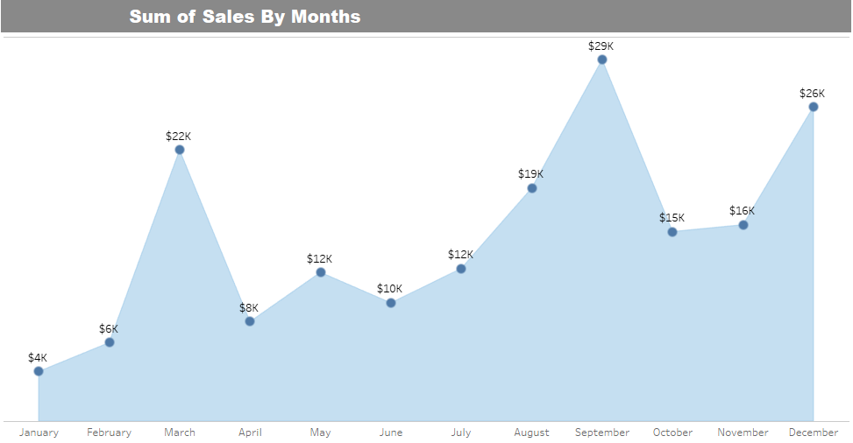

PROBLEM STATEMENTS
What is the sum of sales according to months in all 4 years?
A mixture of Trend line & Area chart is prepared .Filters are also inserted So that we can view data according to different years. Following are the Snapshots of charts which will lead to better understanding of our problem.
Fig 1B.Filter
Fig 1A.Trend Line chart for Total sum of Sales by months

Slide 4
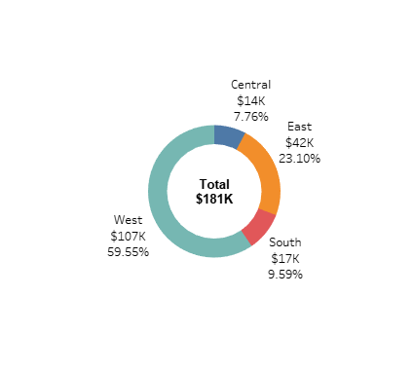
What are the region wise sum of sales ?
A Doughnut chart is prepared for 4 regions Central ,East ,South ,West.
Fig 2 – Regionwise sum of sales

Slide 5
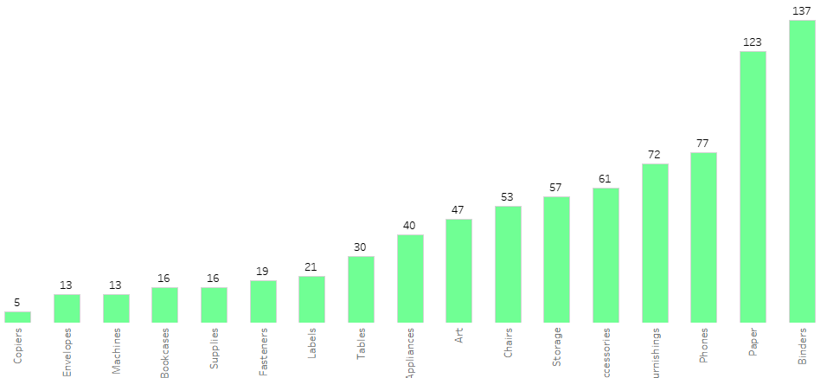
What are the Sub - category wise Count of sales?
A bar chart is prepared which shows count of all Sub categories. Filter of category is used in dashboard to choose between all 3 categories.
FIG 3 – Sub - Categorywise Quantity of sales

Slide 6
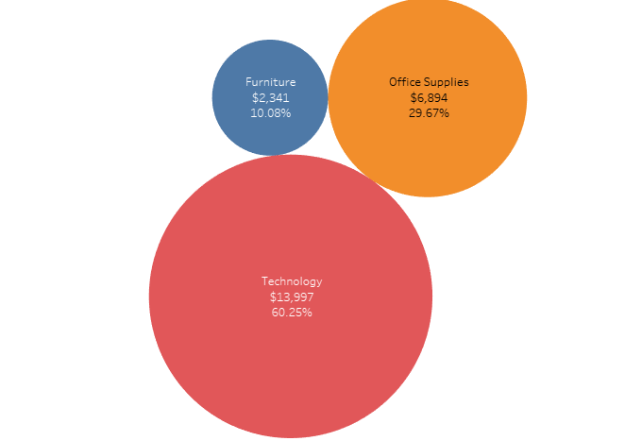
What are the category- wise Profit?
A Circle chart is prepared to show Profit according to all three categories Furniture , Technology & office Supplies.
FIG 4 – Category- wise Profit of sales

Slide 7
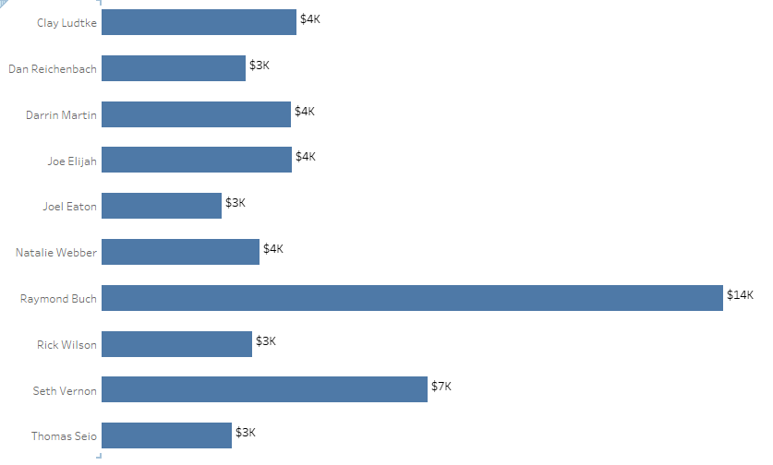
What are Top 10 Customers by Sales ?
A 3- D Horizontal bar is Prepared to show all 10 Top customers by sales.
FIG 5 - Sub – Top 10 Customer by Sales

Slide 8
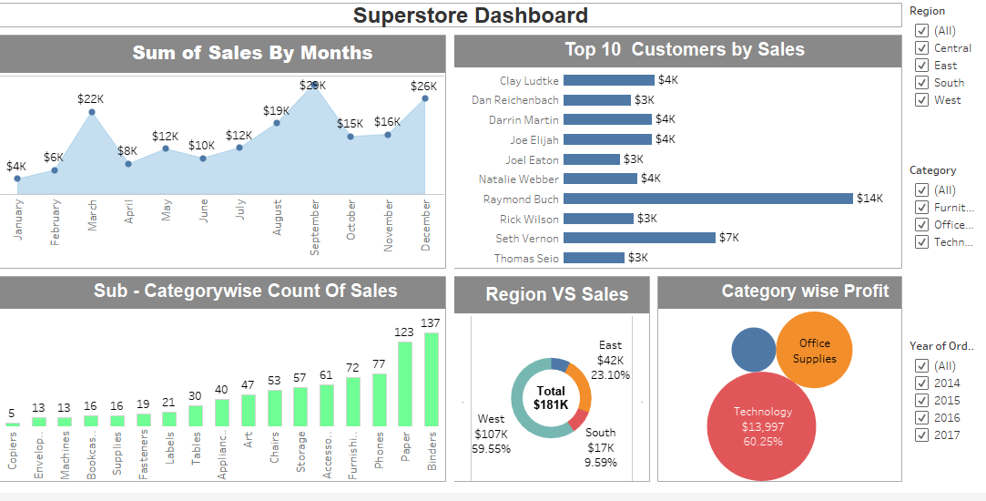
DASHBOARD
Fig 6 – Tableau Dashboard

Slide 9
RESULT & INSIGHTS FROM SUPERSTORE ANALYSIS
West – region has higher sales compared to other 3 regions.
Quantity of sales is higher for office supplies , but sum of sales is greater for technology items as compared to other categories.
The sales in November & December months is much higher as compared to other months in all years.
The profit is much higher in technology items and less in furniture items.
The profit is much higher in last quarter of every year compared to first 2 quarters .

Slide 10
CONCLUSION
Proper Analysis is done for the Superstore database.
A Dynamic Dashboard is constructed & many insights can be found with the help of that dashboard.
Superstore should focus on east, north & south region for more sales.
Superstore should also focus on first 2 quarters of the year to increase their profit.
The video link to get better overview of this presentation is
https://drive.google.com/drive/folders/1uYv8iIIMu-_372FcIljK991tSlvFbZKU?usp=sharing

